Slide 1
Employee Data Analysis using Excel
STUDENT NAME: SRUTHI
REGISTER NO: 312212874 / unm14512022g124
DEPARTMENT: BCOM (GENERAL)
COLLEGE: Mahalashmi women's college of arts and science

Slide 2
PROJECT TITLE
Employee Performance Analysis using Excel

Slide 3


AGENDA
Problem Statement
Project Overview
End Users
Our Solution and Proposition
Dataset Description
Modelling Approach
Results and Discussion
Conclusion
3/21/2024 Annual Review

Slide 4

PROBLEM STATEMENT
> Employee performance analysis is made to identify the performance level of an employee in each department.
> It helps to track the activities and growth of the employees in wholly by department wise.
> And it helps to grant remuneration or appreciation for the respected one.
.

Slide 5

PROJECT OVERVIEW
• Data Breakdown:
Employee Types:
>Contract: 18%
>Full-time: 17%
>Part-Time: 65%
•Gender Distribution: The table shows the number of male and female employees across different employment types (Contract, Full-Time, Part-Time).
•Pie chart: Dispays the percetage dstribution of empoyees by contract type.
•Box Plot: Likely shows the distribution of some numerical data related to employees, though the exact details aren’t clear from the image.
•Understand Distribution: The pie chart helps visualize the proportion of employees in each contract type.
•Gender Insights: The table provides a breakdown of male and female employees in each category, which can be useful for gender diversity analysis.
•Identify Trends: Look for any patterns in the data, such as a higher concentration of one gender in a particular employment type.
.

Slide 6

WHO ARE THE END USERS?
The end users would likely include human resources personnel, managers, or business analysts who analyze workforce demographics based on gender and employment type. They might use this data for diversity planning, resource allocation, or reporting purposes

Slide 7

OUR SOLUTION AND ITS VALUE PROPOSITION
> Conditinal formatting
> Filtering
> Formula used to identify performance level
> Pivotal table for summarising
> Graph - for data visualization ( in units)
> Pie chart - to figure out the overall performance percentage of the each department

Slide 8
Dataset Description
• Employee data downloaded from edunet dashboard.
• Features :
Totally 26 features where available. In that 11 features where considered.
• Employee ID - in numbers
• Names - I text
• Employee type
• Performance level
• Gender - male/ female
• Employee rating

Slide 9

THE "WOW" IN OUR SOLUTION
To identify the performance level.
=IFS(Z8>=5,"VERY HIGH",Z8>=4,"HIGH",Z8>=3,"MED",TRUE,"LOW")
3/21/2024 Annual Review
9

Slide 10
MODELLING
• Data Collection
Downloaded the data from edunet student’s dashboard.
• Feature Collection
Highlighted data which is required using the fill option.
• Data Cleaning:
Identified the missing values using conditional formatting.
• Removed / Filtered the missing data using filter-filter by colour.
Performance level:
• Performance Analysis is based on Department type is filtered by gender( Male employees)
10

Slide 11
• Summary: > Pivot table is created to summaries the data. > Row labels- it is considered as department type. > Column labels- describe the performance level. > Filter – By gender where I perfered the male employees in this data. > Values – To make a count used first name for count of employees in each field. • Visualization: Used the graph chart to analyze the employees (in units) in the department type category. Used the Bar diagram to analyze the employees overall percentage in the department type category.

Slide 12
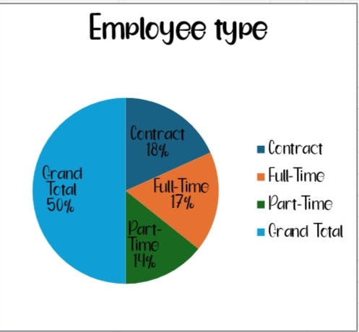
RESULTS
12

Slide 13
conclusion
Therefore the production department employees performs higher comparing to other department and whereas admin offices performs lower comparing to other department. . Hence the Production department employees works more efficiently and effectively comparing to other departments according to the employee data given.

